Slide 1
NUTRITION ASSISTANCE APPLICATION
CUSTOMER JOURNEY

Slide 2
CUSTOMER JOURNEY MAP
AWARENESS
CONSIDERATION
DECISION
LOYALTY
SECURITY

Slide 3
AWARENESS
OUR TARGET IS TO EDUCATE PEOPLE ABOUT HEALTHY EATING BY LIMITING THE CALORIES LEVEL.
SMART NUTRITION AND FOOD CAN PREVENT DISEASES.
OUR TARGET IS TO PROVIDE PROPER NUTRITION AND
HELPS TO MAINTAIN HEALTHY LIFE STYLE.

Slide 4
CONSIDERATION
THE PLANNING OF NUTRITION ASSISTANT IS TO HELP DIETICIANS WITH PROVIDING PROPER NUTRITION.
AND ALSO WE HAVE TO PROVIDE GOOD HEALTH CARE FACILITIES.
INCREASE IN RATE OF OBESITY AND OTHER DISEASES WHICH IS CAUSED DUE TO UNHEALTHY FOOD MAY BE THEIR BIGGEST PAIN POINT.

Slide 5
DECISION
BASED ON THE BMI, THE APP DECIDES WHETHER HE WANTS TO EAT THE FOOD OR NOT.
IF HE IS UNHEALTHY , THE APPLICATION SUGGESTS OTHER FOODS THAT ARE HEALTHIER AND SO THAT HE CAN MAINTAIN HIS DIET.

Slide 6
SECURITY
OUR APP WILL PROVIDE SECURITY AND MAY NOT SHARE CUSTOMER DETAILS AT ANY COST.
IT PROVIDE RELIABLE INFORMATION TO THE USER AND SUGGESTS SOME HEALTHY FOOD SUGGESTIONS.

Slide 7
LOYALTY
WE PROVIDE OUR CUSTOMER WITH EXTENSIVE FOOD DATABASES AND WE MAY NOT SHARE OUR CUSTOMER DETAILS WITH OTHER PARTIES.
OUR APP DELIVERS QUICK AND CUSTOMISED NUTRITION IMPROVEMENT PROGRAMMES FOR VULNERABLE GROUPS.

Slide 8
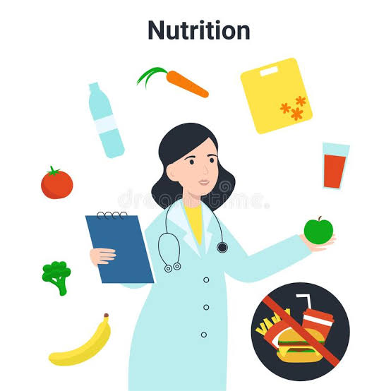
THANK YOU

